Slide 1



















Tahaluf Copyright 2022- All Right Reserved
Harmony IT Solution
learning Hub
Angular
Tahaluf Training Center 2022

Slide 2









Tahaluf Copyright 2022- All Right Reserved
Harmony IT Solution
1
Form Group.
2
Spinner Library.
3
Shared Module.
4
5
6
7
8
8
9

Slide 3










Tahaluf Copyright 2022- All Right Reserved
Harmony IT Solution
Objective

Slide 4
Tahaluf Copyright 2022- All Right Reserved
Harmony IT Solution
The Objective of this lecture
Get to know about the form group and how to use it to validate the group of the form control.
Install and use the spinner library.
Understand the concept of the shared module and which component and module will contain it.

Slide 5
Tahaluf Copyright 2022- All Right Reserved
Harmony IT Solution
Form Group

Slide 6
Tahaluf Copyright 2022- All Right Reserved
Harmony IT Solution
Overview of Form Group
FormGroups are collections of Form controls that track the values and validity of control instances in the group.
One of the building blocks of angular forms is the FormGroup.

Slide 7
Tahaluf Copyright 2022- All Right Reserved
Harmony IT Solution
Overview of Form Group
FormGroups encapsulate all information related to a collection of Form Controls that addresses this problem.
Each of these controls has a value and a validation status.

Slide 8
Tahaluf Copyright 2022- All Right Reserved
Harmony IT Solution
Overview of Form Group
Angular forms can be used by importing the FormsModule (for template-driven forms) and ReactiveFormsModule (for reactive forms) from the @angular/forms package.
import { FormsModule, ReactiveFormsModule } from '@angular/forms’;
imports: [
FormsModule,
ReactiveFormsModule
],

Slide 9
Tahaluf Copyright 2022- All Right Reserved
Harmony IT Solution
Overview of Form Group
Angular forms can be used by importing the FormsModule (for template-driven forms) and ReactiveFormsModule (for reactive forms) from the @angular/forms package.
import { FormsModule, ReactiveFormsModule } from '@angular/forms’;
imports: [
FormsModule,
ReactiveFormsModule
],

Slide 10
Tahaluf Copyright 2022- All Right Reserved
Harmony IT Solution
Overview of Form Group
FormGroup Demo will be in the register component.
Register form template link:
https://codepen.io/anandaprojapati/pen/GmrwYE
Angular material link:
https://material.angular.io/components/input/overview

Slide 11

Tahaluf Copyright 2022- All Right Reserved
Harmony IT Solution
Form Group Example
Create a new object from formGroup class in register.component.ts
registerform:FormGroup=new FormGroup({
email : new FormControl('', [Validators.required,
Validators.email]),
password: new FormControl('',[Validators.required,
Validators.minLength(8)]),
confirmpassword: new FormControl('',[Validators.required, Validators.minLength(8)]),
firstname:new FormControl('',[Validators.required]),
lastname:new FormControl('',[Validators.required]),
gender:new FormControl(),
options:new FormControl() })

Slide 12
Tahaluf Copyright 2022- All Right Reserved
Harmony IT Solution
Form Group Example
Update the form in register.component.html :
Create a new instance from FormGroup.
Make the form tag read from registerform object.
Replace the name property for each input in the form
by formControlName = ‘theNameOfFormControl’
Add the mat-error section for each input.

Slide 13
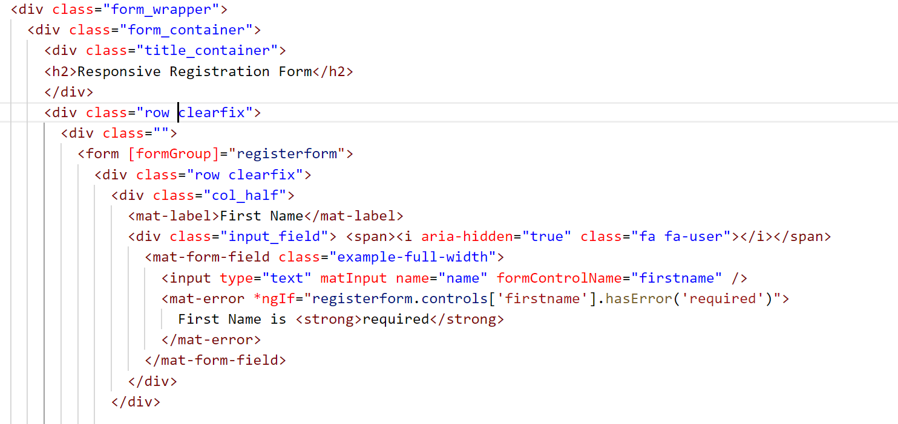
Tahaluf Copyright 2022- All Right Reserved
Harmony IT Solution
Form Group Example
Notes:
<div class="form_wrapper">
<div class="form_container">
<div class="title_container">
<h2>Responsive Registration Form</h2>
</div>
<div class="row clearfix">
<div class="">
<form [formGroup]="registerform">
<div class="row clearfix">
<div class="col_half">
<mat-label>First Name</mat-label>
<div class="input_field"> <span><i aria-hidden="true" class="fa fa-user"></i></span>
<mat-form-field class="example-full-width">
<input type="text" matInput name="name" formControlName="firstname" />
<mat-error *ngIf="registerform.controls['firstname'].hasError('required')">
First Name is <strong>required</strong>
</mat-error>
</mat-form-field>
</div>
</div>
<div class="col_half">
<mat-label>Last Name</mat-label>
<div class="input_field"> <span><i aria-hidden="true" class="fa fa-user"></i></span>
<mat-form-field>
<input type="text" matInput name="name" formControlName="lastname" />
<mat-error *ngIf="registerform.controls['lastname'].hasError('required')">
Last Name is <strong>required</strong>
</mat-error>
</mat-form-field></div></div></div>
<mat-label>Email</mat-label>
<div class="input_field"> <span aria-hidden="true" class="fa fa-envelope"></span>
<mat-form-field class="example-full-width">
<input type="email" matInput name="email" formControlName="email" />
<mat-error *ngIf="registerform.controls['email'].hasError('required') ">
Email is <strong>required</strong>
</mat-error>
<mat-error *ngIf="registerform.controls['email'].hasError('email') ">
Please enter a valid email address
</mat-error>
</mat-form-field>
</div>
<mat-label>Password</mat-label>
<div class="input_field"><span><i aria-hidden="true" class="fa fa-lock"></i></span>
<mat-form-field class="example-full-width">
<input matInput type="password" name="password" formControlName="password" />
<mat-error *ngIf="registerform.controls['password'].hasError('minlength')">
Please enter a strong password
</mat-error>
<mat-error *ngIf="registerform.controls['password'].hasError('required')">
password is <strong>required</strong>
</mat-error>
</mat-form-field>
</div>
<mat-label>Re-type Password</mat-label>
<div class="input_field"> <span><i aria-hidden="true" class="fa fa-lock"></i></span>
<mat-form-field class="example-full-width">
<input matInput type="password" name="password" formControlName="confirmpassword"
(change)="matchError()" />
<mat-error *ngIf="registerform.controls['confirmpassword'].hasError('minlength')">
Please enter a strong password
</mat-error>
<mat-error *ngIf="registerform.controls['confirmpassword'].hasError('required')">
password is <strong>required</strong>
</mat-error>
<mat-error *ngIf="registerform.controls['confirmpassword'].hasError('mismatch')">
confirmPassword must match with password
</mat-error>
</mat-form-field>
</div>
<div class="input_field radio_option">
<input type="radio" id="rd1" value="male" formControlName="gender">
<label for="rd1">Male</label>
<input type="radio" id="rd2" value="female" formControlName="gender">
<label for="rd2">Female</label>
</div>
<div class="input_field select_option">
<label>Select a country</label>
<select formControlName="options">
<option>Jordan</option>
<option>UAE</option>
</select>
<div class="select_arrow"></div>
</div>
<button class="btn btn-success example-full-width"
[disabled]="!registerform.valid" (click)="submit()"
type="submit" value="Register">Register
</button>
<p style="text-align: center;cursor: pointer;" (click)="goToLogin()">Already have account </p>
</form>
</div>
</div>
</div>
</div>

Slide 14
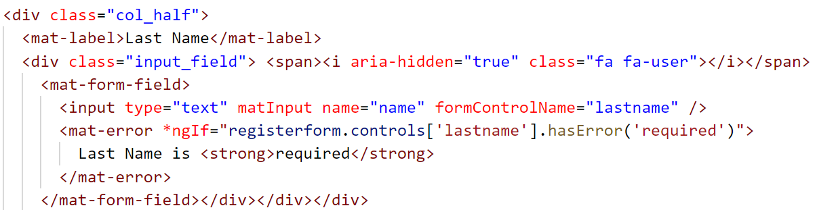
Tahaluf Copyright 2022- All Right Reserved
Harmony IT Solution
Form Group Example
Notes:
<div class="form_wrapper">
<div class="form_container">
<div class="title_container">
<h2>Responsive Registration Form</h2>
</div>
<div class="row clearfix">
<div class="">
<form [formGroup]="registerform">
<div class="row clearfix">
<div class="col_half">
<mat-label>First Name</mat-label>
<div class="input_field"> <span><i aria-hidden="true" class="fa fa-user"></i></span>
<mat-form-field class="example-full-width">
<input type="text" matInput name="name" formControlName="firstname" />
<mat-error *ngIf="registerform.controls['firstname'].hasError('required')">
First Name is <strong>required</strong>
</mat-error>
</mat-form-field>
</div>
</div>
<div class="col_half">
<mat-label>Last Name</mat-label>
<div class="input_field"> <span><i aria-hidden="true" class="fa fa-user"></i></span>
<mat-form-field>
<input type="text" matInput name="name" formControlName="lastname" />
<mat-error *ngIf="registerform.controls['lastname'].hasError('required')">
Last Name is <strong>required</strong>
</mat-error>
</mat-form-field></div></div></div>
<mat-label>Email</mat-label>
<div class="input_field"> <span aria-hidden="true" class="fa fa-envelope"></span>
<mat-form-field class="example-full-width">
<input type="email" matInput name="email" formControlName="email" />
<mat-error *ngIf="registerform.controls['email'].hasError('required') ">
Email is <strong>required</strong>
</mat-error>
<mat-error *ngIf="registerform.controls['email'].hasError('email') ">
Please enter a valid email address
</mat-error>
</mat-form-field>
</div>
<mat-label>Password</mat-label>
<div class="input_field"><span><i aria-hidden="true" class="fa fa-lock"></i></span>
<mat-form-field class="example-full-width">
<input matInput type="password" name="password" formControlName="password" />
<mat-error *ngIf="registerform.controls['password'].hasError('minlength')">
Please enter a strong password
</mat-error>
<mat-error *ngIf="registerform.controls['password'].hasError('required')">
password is <strong>required</strong>
</mat-error>
</mat-form-field>
</div>
<mat-label>Re-type Password</mat-label>
<div class="input_field"> <span><i aria-hidden="true" class="fa fa-lock"></i></span>
<mat-form-field class="example-full-width">
<input matInput type="password" name="password" formControlName="confirmpassword"
(change)="matchError()" />
<mat-error *ngIf="registerform.controls['confirmpassword'].hasError('minlength')">
Please enter a strong password
</mat-error>
<mat-error *ngIf="registerform.controls['confirmpassword'].hasError('required')">
password is <strong>required</strong>
</mat-error>
<mat-error *ngIf="registerform.controls['confirmpassword'].hasError('mismatch')">
confirmPassword must match with password
</mat-error>
</mat-form-field>
</div>
<div class="input_field radio_option">
<input type="radio" id="rd1" value="male" formControlName="gender">
<label for="rd1">Male</label>
<input type="radio" id="rd2" value="female" formControlName="gender">
<label for="rd2">Female</label>
</div>
<div class="input_field select_option">
<label>Select a country</label>
<select formControlName="options">
<option>Jordan</option>
<option>UAE</option>
</select>
<div class="select_arrow"></div>
</div>
<button class="btn btn-success example-full-width"
[disabled]="!registerform.valid" (click)="submit()"
type="submit" value="Register">Register
</button>
<p style="text-align: center;cursor: pointer;" (click)="goToLogin()">Already have account </p>
</form>
</div>
</div>
</div>
</div>

Slide 15
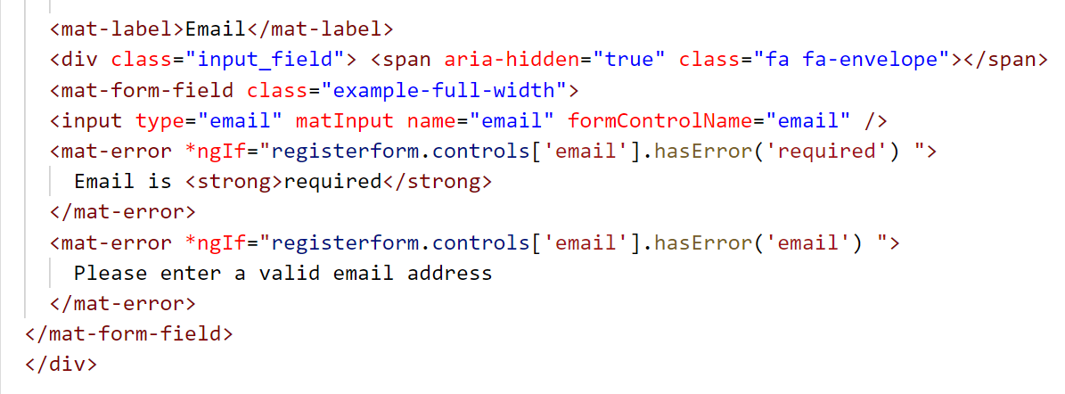
Tahaluf Copyright 2022- All Right Reserved
Harmony IT Solution
Form Group Example
Notes:
<div class="form_wrapper">
<div class="form_container">
<div class="title_container">
<h2>Responsive Registration Form</h2>
</div>
<div class="row clearfix">
<div class="">
<form [formGroup]="registerform">
<div class="row clearfix">
<div class="col_half">
<mat-label>First Name</mat-label>
<div class="input_field"> <span><i aria-hidden="true" class="fa fa-user"></i></span>
<mat-form-field class="example-full-width">
<input type="text" matInput name="name" formControlName="firstname" />
<mat-error *ngIf="registerform.controls['firstname'].hasError('required')">
First Name is <strong>required</strong>
</mat-error>
</mat-form-field>
</div>
</div>
<div class="col_half">
<mat-label>Last Name</mat-label>
<div class="input_field"> <span><i aria-hidden="true" class="fa fa-user"></i></span>
<mat-form-field>
<input type="text" matInput name="name" formControlName="lastname" />
<mat-error *ngIf="registerform.controls['lastname'].hasError('required')">
Last Name is <strong>required</strong>
</mat-error>
</mat-form-field></div></div></div>
<mat-label>Email</mat-label>
<div class="input_field"> <span aria-hidden="true" class="fa fa-envelope"></span>
<mat-form-field class="example-full-width">
<input type="email" matInput name="email" formControlName="email" />
<mat-error *ngIf="registerform.controls['email'].hasError('required') ">
Email is <strong>required</strong>
</mat-error>
<mat-error *ngIf="registerform.controls['email'].hasError('email') ">
Please enter a valid email address
</mat-error>
</mat-form-field>
</div>
<mat-label>Password</mat-label>
<div class="input_field"><span><i aria-hidden="true" class="fa fa-lock"></i></span>
<mat-form-field class="example-full-width">
<input matInput type="password" name="password" formControlName="password" />
<mat-error *ngIf="registerform.controls['password'].hasError('minlength')">
Please enter a strong password
</mat-error>
<mat-error *ngIf="registerform.controls['password'].hasError('required')">
password is <strong>required</strong>
</mat-error>
</mat-form-field>
</div>
<mat-label>Re-type Password</mat-label>
<div class="input_field"> <span><i aria-hidden="true" class="fa fa-lock"></i></span>
<mat-form-field class="example-full-width">
<input matInput type="password" name="password" formControlName="confirmpassword"
(change)="matchError()" />
<mat-error *ngIf="registerform.controls['confirmpassword'].hasError('minlength')">
Please enter a strong password
</mat-error>
<mat-error *ngIf="registerform.controls['confirmpassword'].hasError('required')">
password is <strong>required</strong>
</mat-error>
<mat-error *ngIf="registerform.controls['confirmpassword'].hasError('mismatch')">
confirmPassword must match with password
</mat-error>
</mat-form-field>
</div>
<div class="input_field radio_option">
<input type="radio" id="rd1" value="male" formControlName="gender">
<label for="rd1">Male</label>
<input type="radio" id="rd2" value="female" formControlName="gender">
<label for="rd2">Female</label>
</div>
<div class="input_field select_option">
<label>Select a country</label>
<select formControlName="options">
<option>Jordan</option>
<option>UAE</option>
</select>
<div class="select_arrow"></div>
</div>
<button class="btn btn-success example-full-width"
[disabled]="!registerform.valid" (click)="submit()"
type="submit" value="Register">Register
</button>
<p style="text-align: center;cursor: pointer;" (click)="goToLogin()">Already have account </p>
</form>
</div>
</div>
</div>
</div>

Slide 16
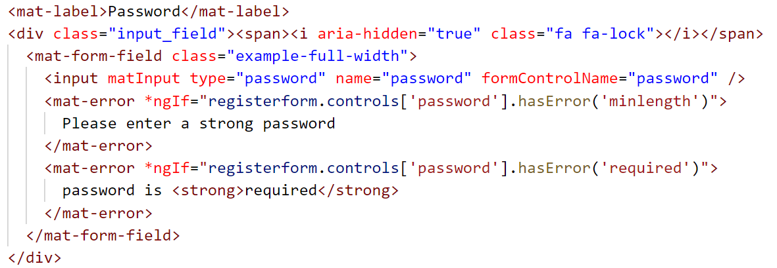
Tahaluf Copyright 2022- All Right Reserved
Harmony IT Solution
Form Group Example
Notes:
<div class="form_wrapper">
<div class="form_container">
<div class="title_container">
<h2>Responsive Registration Form</h2>
</div>
<div class="row clearfix">
<div class="">
<form [formGroup]="registerform">
<div class="row clearfix">
<div class="col_half">
<mat-label>First Name</mat-label>
<div class="input_field"> <span><i aria-hidden="true" class="fa fa-user"></i></span>
<mat-form-field class="example-full-width">
<input type="text" matInput name="name" formControlName="firstname" />
<mat-error *ngIf="registerform.controls['firstname'].hasError('required')">
First Name is <strong>required</strong>
</mat-error>
</mat-form-field>
</div>
</div>
<div class="col_half">
<mat-label>Last Name</mat-label>
<div class="input_field"> <span><i aria-hidden="true" class="fa fa-user"></i></span>
<mat-form-field>
<input type="text" matInput name="name" formControlName="lastname" />
<mat-error *ngIf="registerform.controls['lastname'].hasError('required')">
Last Name is <strong>required</strong>
</mat-error>
</mat-form-field></div></div></div>
<mat-label>Email</mat-label>
<div class="input_field"> <span aria-hidden="true" class="fa fa-envelope"></span>
<mat-form-field class="example-full-width">
<input type="email" matInput name="email" formControlName="email" />
<mat-error *ngIf="registerform.controls['email'].hasError('required') ">
Email is <strong>required</strong>
</mat-error>
<mat-error *ngIf="registerform.controls['email'].hasError('email') ">
Please enter a valid email address
</mat-error>
</mat-form-field>
</div>
<mat-label>Password</mat-label>
<div class="input_field"><span><i aria-hidden="true" class="fa fa-lock"></i></span>
<mat-form-field class="example-full-width">
<input matInput type="password" name="password" formControlName="password" />
<mat-error *ngIf="registerform.controls['password'].hasError('minlength')">
Please enter a strong password
</mat-error>
<mat-error *ngIf="registerform.controls['password'].hasError('required')">
password is <strong>required</strong>
</mat-error>
</mat-form-field>
</div>
<mat-label>Re-type Password</mat-label>
<div class="input_field"> <span><i aria-hidden="true" class="fa fa-lock"></i></span>
<mat-form-field class="example-full-width">
<input matInput type="password" name="password" formControlName="confirmpassword"
(change)="matchError()" />
<mat-error *ngIf="registerform.controls['confirmpassword'].hasError('minlength')">
Please enter a strong password
</mat-error>
<mat-error *ngIf="registerform.controls['confirmpassword'].hasError('required')">
password is <strong>required</strong>
</mat-error>
<mat-error *ngIf="registerform.controls['confirmpassword'].hasError('mismatch')">
confirmPassword must match with password
</mat-error>
</mat-form-field>
</div>
<div class="input_field radio_option">
<input type="radio" id="rd1" value="male" formControlName="gender">
<label for="rd1">Male</label>
<input type="radio" id="rd2" value="female" formControlName="gender">
<label for="rd2">Female</label>
</div>
<div class="input_field select_option">
<label>Select a country</label>
<select formControlName="options">
<option>Jordan</option>
<option>UAE</option>
</select>
<div class="select_arrow"></div>
</div>
<button class="btn btn-success example-full-width"
[disabled]="!registerform.valid" (click)="submit()"
type="submit" value="Register">Register
</button>
<p style="text-align: center;cursor: pointer;" (click)="goToLogin()">Already have account </p>
</form>
</div>
</div>
</div>
</div>

Slide 17
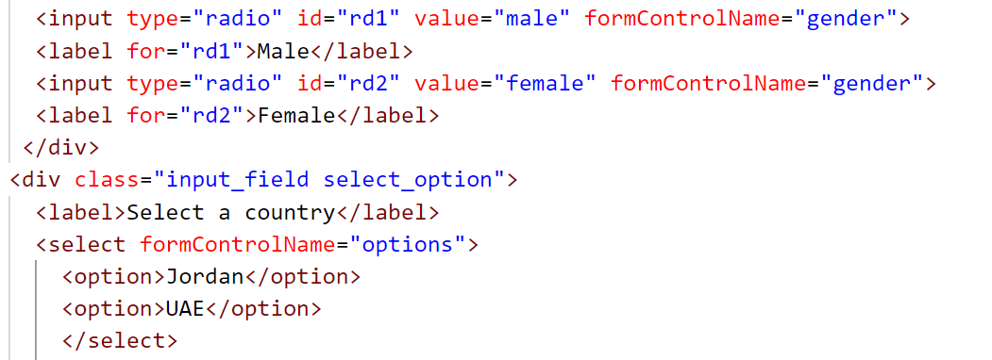
Tahaluf Copyright 2022- All Right Reserved
Harmony IT Solution
Form Group Example
Notes:
<div class="form_wrapper">
<div class="form_container">
<div class="title_container">
<h2>Responsive Registration Form</h2>
</div>
<div class="row clearfix">
<div class="">
<form [formGroup]="registerform">
<div class="row clearfix">
<div class="col_half">
<mat-label>First Name</mat-label>
<div class="input_field"> <span><i aria-hidden="true" class="fa fa-user"></i></span>
<mat-form-field class="example-full-width">
<input type="text" matInput name="name" formControlName="firstname" />
<mat-error *ngIf="registerform.controls['firstname'].hasError('required')">
First Name is <strong>required</strong>
</mat-error>
</mat-form-field>
</div>
</div>
<div class="col_half">
<mat-label>Last Name</mat-label>
<div class="input_field"> <span><i aria-hidden="true" class="fa fa-user"></i></span>
<mat-form-field>
<input type="text" matInput name="name" formControlName="lastname" />
<mat-error *ngIf="registerform.controls['lastname'].hasError('required')">
Last Name is <strong>required</strong>
</mat-error>
</mat-form-field></div></div></div>
<mat-label>Email</mat-label>
<div class="input_field"> <span aria-hidden="true" class="fa fa-envelope"></span>
<mat-form-field class="example-full-width">
<input type="email" matInput name="email" formControlName="email" />
<mat-error *ngIf="registerform.controls['email'].hasError('required') ">
Email is <strong>required</strong>
</mat-error>
<mat-error *ngIf="registerform.controls['email'].hasError('email') ">
Please enter a valid email address
</mat-error>
</mat-form-field>
</div>
<mat-label>Password</mat-label>
<div class="input_field"><span><i aria-hidden="true" class="fa fa-lock"></i></span>
<mat-form-field class="example-full-width">
<input matInput type="password" name="password" formControlName="password" />
<mat-error *ngIf="registerform.controls['password'].hasError('minlength')">
Please enter a strong password
</mat-error>
<mat-error *ngIf="registerform.controls['password'].hasError('required')">
password is <strong>required</strong>
</mat-error>
</mat-form-field>
</div>
<mat-label>Re-type Password</mat-label>
<div class="input_field"> <span><i aria-hidden="true" class="fa fa-lock"></i></span>
<mat-form-field class="example-full-width">
<input matInput type="password" name="password" formControlName="confirmpassword"
(change)="matchError()" />
<mat-error *ngIf="registerform.controls['confirmpassword'].hasError('minlength')">
Please enter a strong password
</mat-error>
<mat-error *ngIf="registerform.controls['confirmpassword'].hasError('required')">
password is <strong>required</strong>
</mat-error>
<mat-error *ngIf="registerform.controls['confirmpassword'].hasError('mismatch')">
confirmPassword must match with password
</mat-error>
</mat-form-field>
</div>
<div class="input_field radio_option">
<input type="radio" id="rd1" value="male" formControlName="gender">
<label for="rd1">Male</label>
<input type="radio" id="rd2" value="female" formControlName="gender">
<label for="rd2">Female</label>
</div>
<div class="input_field select_option">
<label>Select a country</label>
<select formControlName="options">
<option>Jordan</option>
<option>UAE</option>
</select>
<div class="select_arrow"></div>
</div>
<button class="btn btn-success example-full-width"
[disabled]="!registerform.valid" (click)="submit()"
type="submit" value="Register">Register
</button>
<p style="text-align: center;cursor: pointer;" (click)="goToLogin()">Already have account </p>
</form>
</div>
</div>
</div>
</div>

Slide 18
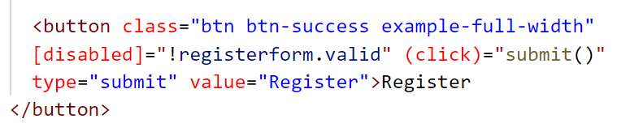
Tahaluf Copyright 2022- All Right Reserved
Harmony IT Solution
Form Group Example
Notes:
<div class="form_wrapper">
<div class="form_container">
<div class="title_container">
<h2>Responsive Registration Form</h2>
</div>
<div class="row clearfix">
<div class="">
<form [formGroup]="registerform">
<div class="row clearfix">
<div class="col_half">
<mat-label>First Name</mat-label>
<div class="input_field"> <span><i aria-hidden="true" class="fa fa-user"></i></span>
<mat-form-field class="example-full-width">
<input type="text" matInput name="name" formControlName="firstname" />
<mat-error *ngIf="registerform.controls['firstname'].hasError('required')">
First Name is <strong>required</strong>
</mat-error>
</mat-form-field>
</div>
</div>
<div class="col_half">
<mat-label>Last Name</mat-label>
<div class="input_field"> <span><i aria-hidden="true" class="fa fa-user"></i></span>
<mat-form-field>
<input type="text" matInput name="name" formControlName="lastname" />
<mat-error *ngIf="registerform.controls['lastname'].hasError('required')">
Last Name is <strong>required</strong>
</mat-error>
</mat-form-field></div></div></div>
<mat-label>Email</mat-label>
<div class="input_field"> <span aria-hidden="true" class="fa fa-envelope"></span>
<mat-form-field class="example-full-width">
<input type="email" matInput name="email" formControlName="email" />
<mat-error *ngIf="registerform.controls['email'].hasError('required') ">
Email is <strong>required</strong>
</mat-error>
<mat-error *ngIf="registerform.controls['email'].hasError('email') ">
Please enter a valid email address
</mat-error>
</mat-form-field>
</div>
<mat-label>Password</mat-label>
<div class="input_field"><span><i aria-hidden="true" class="fa fa-lock"></i></span>
<mat-form-field class="example-full-width">
<input matInput type="password" name="password" formControlName="password" />
<mat-error *ngIf="registerform.controls['password'].hasError('minlength')">
Please enter a strong password
</mat-error>
<mat-error *ngIf="registerform.controls['password'].hasError('required')">
password is <strong>required</strong>
</mat-error>
</mat-form-field>
</div>
<mat-label>Re-type Password</mat-label>
<div class="input_field"> <span><i aria-hidden="true" class="fa fa-lock"></i></span>
<mat-form-field class="example-full-width">
<input matInput type="password" name="password" formControlName="confirmpassword"
(change)="matchError()" />
<mat-error *ngIf="registerform.controls['confirmpassword'].hasError('minlength')">
Please enter a strong password
</mat-error>
<mat-error *ngIf="registerform.controls['confirmpassword'].hasError('required')">
password is <strong>required</strong>
</mat-error>
<mat-error *ngIf="registerform.controls['confirmpassword'].hasError('mismatch')">
confirmPassword must match with password
</mat-error>
</mat-form-field>
</div>
<div class="input_field radio_option">
<input type="radio" id="rd1" value="male" formControlName="gender">
<label for="rd1">Male</label>
<input type="radio" id="rd2" value="female" formControlName="gender">
<label for="rd2">Female</label>
</div>
<div class="input_field select_option">
<label>Select a country</label>
<select formControlName="options">
<option>Jordan</option>
<option>UAE</option>
</select>
<div class="select_arrow"></div>
</div>
<button class="btn btn-success example-full-width"
[disabled]="!registerform.valid" (click)="submit()"
type="submit" value="Register">Register
</button>
<p style="text-align: center;cursor: pointer;" (click)="goToLogin()">Already have account </p>
</form>
</div>
</div>
</div>
</div>

Slide 19
Tahaluf Copyright 2022- All Right Reserved
Harmony IT Solution
Form Group Example
In register.component.ts
submit(){
console.log(this.registerform.value);
}

Slide 20

Tahaluf Copyright 2022- All Right Reserved
Harmony IT Solution
Exercises
Add a new input called to confirm the password and check whether it's the same as the password.
Notes:
In register.component.html
<mat-label>Re-type Password</mat-label>
<div class="input_field"> <span><i aria-hidden="true“
class="fa fa-lock"></i></span>
<mat-form-field class="example-full-width">
<input matInput type="password" name="password“
formControlName="confirmpassword“ (change)="matchError()" />
<mat-error*ngIf="registerform.controls['confirmpassword’]
.hasError('minlength’)">Please enter a strong password
</mat-error>
<mat-error*ngIf="registerform.controls['confirmpassword’]
.hasError('required’)">
password is <strong>required</strong>
</mat-error>
<mat-error *ngIf="registerform.controls['confirmpassword’]
.hasError(
'mismatch’)">
confirmPassword must match with password
</mat-error>
</mat-form-field>
</div>
In register.component.ts
matchError(){
if(this.registerform.controls['password’]
.value==this.registerform.controls['confirmpassword'].value)
this.registerform.controls['confirmpassword’]
.setErrors(null);
else
this.registerform.controls['confirmpassword’]
.setErrors({mismatch:true});
}

Slide 21
Tahaluf Copyright 2022- All Right Reserved
Harmony IT Solution
Exercises
Add the following paragraph "Already have an account" to route it to the login component.
Notes:
In register.component.html
<p style="text-align: center;cursor: pointer;"
(click)="goToLogin()">Already have account </p>
Add the Implementation of the function on the typescript file.
goToLogin(){
this.router.navigate(['security/login']) }
Note: you should declare an object of route
service on the constructor.

Slide 22
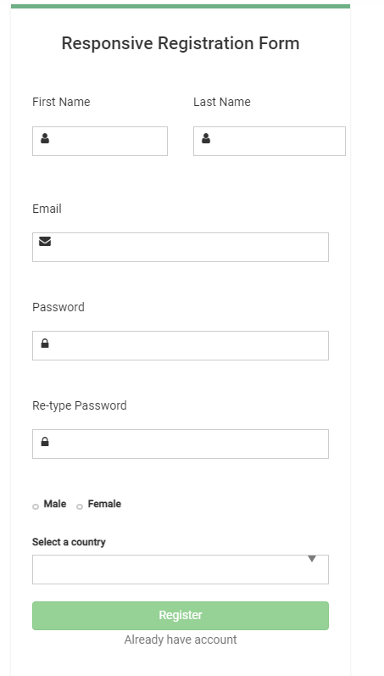
Tahaluf Copyright 2022- All Right Reserved
Harmony IT Solution
Form Group Example Result

Slide 23
Tahaluf Copyright 2022- All Right Reserved
Harmony IT Solution
Spinner Library

Slide 24
Tahaluf Copyright 2022- All Right Reserved
Harmony IT Solution
Overview of Spinner
An Angular library for loading spinners, ngx spinners shows that data is loading in real-time to the user, and can be used to give the user a notification.
A loader is used to display the loading state of data in an application.

Slide 25
Tahaluf Copyright 2022- All Right Reserved
Harmony IT Solution
How to add the Spinner to the project
Step one: from npm website (node package manager ) searches to ngx-spinner library.
Step two: Install the library using the terminal.
This is the installation command.
npm i ngx-spinner

Slide 26
Tahaluf Copyright 2022- All Right Reserved
Harmony IT Solution
How to add the Spinner to the project
Step three: import the NgxSpinnerModule in the root module (App Module).
import { NgxSpinnerModule } from "ngx-spinner";
Step four: Adding the template you want in the App Component.
Step five: Add CSS animation files to angular.json config.

Slide 27
Tahaluf Copyright 2022- All Right Reserved
Harmony IT Solution
How to add the Spinner to the project
Step six: Add NgxSpinnerService service wherever you want to use the ngx-spinner and create an object of this service in the constructor.
import { NgxSpinnerService } from "ngx-spinner";
private spinner: NgxSpinnerService
By using this object you can show and hide the spinner using the show and hide.

Slide 28
Tahaluf Copyright 2022- All Right Reserved
Harmony IT Solution
Spinner Example
Add the spinner in the register component when the user clicks on submit button.
In the app.module.ts:
import { NgxSpinnerModule } from "ngx-spinner";
And add the NgxSpinnerModule in the import array.

Slide 29
Tahaluf Copyright 2022- All Right Reserved
Harmony IT Solution
Spinner Example
2. Add the template in the app component:
<ngx-spinner bdColor = "rgba(0, 0, 0, 0.8)" size = "medium"
color = "#fff"
type = "ball-fussion"
[fullScreen] = "true">
<p style="color: white" > Loading... </p>
</ngx-spinner>

Slide 30
Tahaluf Copyright 2022- All Right Reserved
Harmony IT Solution
Spinner Example
3. Add CSS animation files to angular.json config.
"node_modules/ngx-spinner/animations/ball-scale-multiple.css"
"styles": [
./node_modules/@angular/material/prebuilt-themes/
indigo-pink.css,
"src/styles.css",
"node_modules/ngx-spinner/animations/
ball-scale-multiple.css"
],

Slide 31
Tahaluf Copyright 2022- All Right Reserved
Harmony IT Solution
Spinner Example
4. Add NgxSpinnerService service in the register component
In register.component.ts
import { NgxSpinnerService } from "ngx-spinner";
In the constructor :
constructor(private router:Router,
private spinner: NgxSpinnerService)

Slide 32
Tahaluf Copyright 2022- All Right Reserved
Harmony IT Solution
Spinner Example
5. Use the show and hide functions in the submit method.
submit(){
console.log(this.registerform.value);
this.spinner.show();
setTimeout(() => {
/** spinner ends after 5 seconds */
this.spinner.hide();
}, 5000);
}

Slide 33
Tahaluf Copyright 2022- All Right Reserved
Harmony IT Solution
Shared Module

Slide 34
Tahaluf Copyright 2022- All Right Reserved
Harmony IT Solution
Overview of Shared Module
Your code can be organized and streamlined by creating shared modules.
Directives, pipes, and components that are commonly used can be put into this module, which you can then import wherever you need them in your application.

Slide 35
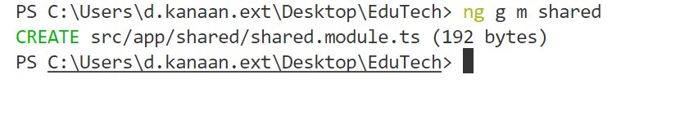
Tahaluf Copyright 2022- All Right Reserved
Harmony IT Solution
Generate A Shared Module
In order to generate a shared module, the same command to generate any other module will be used.

Slide 36
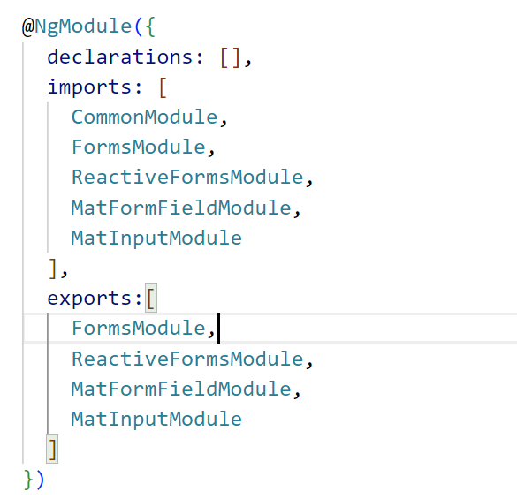
Tahaluf Copyright 2022- All Right Reserved
Harmony IT Solution
Consider the following:
The CommonModule is imported because the
module's component needs common directives.
The module declares and exports utility pipes,
directives, and components.
It re-exports all modules, components,
pipes, and directives that are declared and imported.

Slide 37
Tahaluf Copyright 2022- All Right Reserved
Harmony IT Solution
Notes:
You can create a template that you will use multiple times, such as navbars, footers, or sidebars, in the shared module.

Slide 38
Tahaluf Copyright 2022- All Right Reserved
Harmony IT Solution
Exercises
Create a navbar and footer components in the shared module and transfer the template from the app module to the shared module.
Notes:
In the terminal :
ng g c shared/navbar
ng g c shared/footer
In the navbar.html
<!-- MENU -->
<section class="navbar custom-navbar navbar-fixed-top" role="navigation">
<div class="container">
<div class="navbar-header">
<button class="navbar-toggle" data-toggle="collapse" data-target=".navbar-collapse">
<span class="icon icon-bar"></span>
<span class="icon icon-bar"></span>
<span class="icon icon-bar"></span>
</button>
<!-- lOGO TEXT HERE -->
<a href="#" class="navbar-brand">EduTech</a>
</div>
<!-- MENU LINKS -->
<div class="collapse navbar-collapse">
<ul class="nav navbar-nav navbar-nav-first">
<li><a routerLink="/home" class="smoothScroll"> Home</a></li>
<li><a href="./about" class="smoothScroll">About</a></li>
<li><a href="./course" class="smoothScroll">Courses</a></li>
<li><a href="#testimonial" class="smoothScroll">Reviews</a></li>
<li><a href="./contact" class="smoothScroll">Contact</a></li>
<li><a href="./security/login" class="smoothScroll">Login</a></li>
<li><a href="./security/register" class="smoothScroll">Register</a></li>
</ul>
<ul class="nav navbar-nav navbar-right"><li><a href="#"><i class="fa fa-phone"></i> +65
2244 1100</a></li> </ul>
</div>
</div>
</section>
In footer.html
<!-- FOOTER -->
<footer id="footer">
<div class="container">
<div class="row">
<div class="col-md-4 col-sm-6">
<div class="footer-info">
<div class="section-title">
<h2>Headquarter</h2>
</div>
<address>
<p>1800 dapibus a tortor pretium,<br> Integer nisl dui, ABC 12000</p>
</address>
<ul class="social-icon">
<li><a href="#" class="fa fa-facebook-square" attr="facebook icon"></a></li>
<li><a href="#" class="fa fa-twitter"></a></li>
<li><a href="#" class="fa fa-instagram"></a></li>
</ul>
<div class="copyright-text">
<p>Copyright &copy; 2019 Company Name</p>
<p>Design: TemplateMo</p>
</div>
</div>
</div>
<div class="col-md-4 col-sm-6">
<div class="footer-info">
<div class="section-title">
<h2>Contact Info</h2>
</div>
<address>
<p>+65 2244 1100, +66 1800 1100</p>
<p><a href="mailto:youremail.co">hello@youremail.co</a></p>
</address>
<div class="footer_menu">
<h2>Quick Links</h2>
<ul>
<li><a href="#">Career</a></li>
<li><a href="#">Investor</a></li>
<li><a href="#">Terms & Conditions</a></li>
<li><a href="#">Refund Policy</a></li>
</ul>
</div>
</div>
</div>
<div class="col-md-4 col-sm-12">
<div class="footer-info newsletter-form">
<div class="section-title">
<h2>Newsletter Signup</h2>
</div>
<div>
<div class="form-group">
<form action="#" method="get">
<input type="email" class="form-control" placeholder="Enter your email" name="email" id="email" required="">
<input type="submit" class="form-control" name="submit" id="form-submit" value="Send me">
</form>
<span><sup>*</sup> Please note - we do not spam your email.</span>
</div>
</div>
</div>
</div>
</div>
</div>
</footer>

Slide 39
Tahaluf Copyright 2022- All Right Reserved
Harmony IT Solution
Include the shared module
In order to include the navbar and footer component in the login component, you need first import the shared module in the auth module, then use the selector of the navbar and footer component in the login component.

Slide 40
Tahaluf Copyright 2022- All Right Reserved
Harmony IT Solution
References
[1] Angular, “Angular,” Angular.io, 2019. https://angular.io/
[2] “Complete Angular Tutorial For Beginners,” TekTutorialsHub. https://www.tektutorialshub.com/angular-tutorial/
[3]“npm | build amazing things,” Npmjs.com, 2019. https://www.npmjs.com/
[4]“Angular Tutorial for Beginners | Simplilearn,” Simplilearn.com. https://www.simplilearn.com/tutorials/angular-tutorial (accessed Aug. 19, 2022).
Overview of Database

Slide 41








Tahaluf Copyright 2022- All Right Reserved
Harmony IT Solution
Thank youﻂﺤﻧ
Any Question?

